Slide 1
Factors associated with COVID-19 vaccine uptake among hospital admitted health workers in South Africa: 2020 to 2022 (preliminary analysis).
Prepared by Jonathan Ramodike.
DATE - 30th November 2020
Healthy, Safe, Happy & Sustainable Workplaces
PROMOTING DECENT WORK THROUGH CUTTING EDGE RESEARCH, SPECIALISED SERVICES, INFORMATION, TEACHING AND TRAINING

Slide 2
Background
Health workers (HWs) have an increased risk of acquiring COVID-19 than the general population because of the nature of their work.
Notes:
I would like to take you back to when the vaccine program started in Feb 2021 whereby prioritization of COVID-19 vaccinations towards HWs first and people over 60. Now this is because many factors can increase the risk of COVID-19 transmission among HWs, including: lack of protective resources during treatment of patients, such as adequate personnel protective equipment, masks, and gloves; inappropriate training on specimen/patient handling and infection control; and appropriate infection control strategies not being properly implemented in some healthcare facilities. Aside from the risks of acquiring SARS-CoV-2 in the workplace, HCWs may also be infected in their communities. Hence the

Slide 3
Introduction
COVID-19 vaccines play a critical role in continuing to protect against severe disease, hospitalization, and death from known circulating variants and are contributing to controlling the spread of the disease, thus their impact on infection and serious illness is significant.
Both vaccinated and unvaccinated people also need to be aware of the additional protective behaviours required to control the pandemic.
The Path to Immunity
At this pace, it will take another 10 months until 75% of the population of the world has received at least one dose.
The South Africa rollout of the vaccine target is to vaccinate 67% of the population by the end of 2021, which will allow us to achieve herd immunity.
Notes:
Different countries have different approaches (e.g. targets, types of vaccines used)

Slide 4
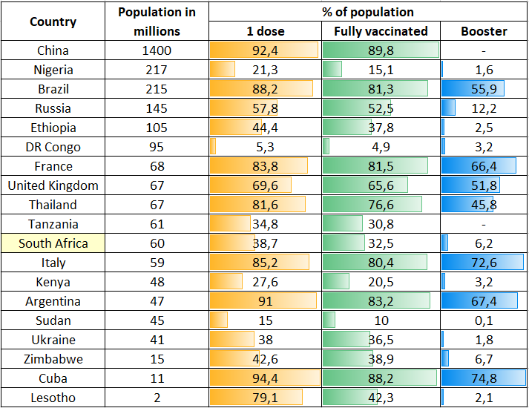
Introduction continued
Some Countries Vaccine uptake
SA has vaccinated > 67% of public healthcare workers
WC > 76%
GP 64%
Notes:
Some countries (especially developed) have high uptake & some (especially underdeveloped) have low vaccination uptake.
All underdeveloped countries are under 45% fully vaccinated
South Africa has low uptake overall for more reasons yet to be understood.
South Africa has vaccinated more than 67% of public healthcare workers, says President Cyril Ramaphosa (May 30, 2021) (SA gov news agency)
The Citizen that states GP has vaccinated 64% of its HWs (24 Nov 2021), Western Cape health department more than 76% of its employees vaccinated (the citizen 24 Nov 2021) NarissaS@citizen.co.za 0109764151

Slide 5
Aim
To understand South African HWs’ COVID-19 vaccination uptake and its hypothesized determinants.
Objective
Describes the characteristics of admitted HWs in South Africa and assess factors associated with in hospital admissions and vaccine uptake.

Slide 6
Methods
Study design
Cross sectional survey (DATCOV surveillance database) using data on hospital admissions.
Study setting
Reports from 464/670 facilities in all nine provinces of South Africa.
Study population
Only HWs’ records (6012/10960 = 55%) that had complete information on vaccination status were used (No sampling was done as all of the applicable DATCOV surveillance records were used).
Data collection
Extracted records from electronic DATCOV surveillance database.
Data analysis
Data was cleaned and analyzed using Microsoft excel and STATA. Regression analysis was done on STATA.
Ethical considerations
Approval was granted from University of the Witwatersrand as part of a national surveillance program.

Slide 7
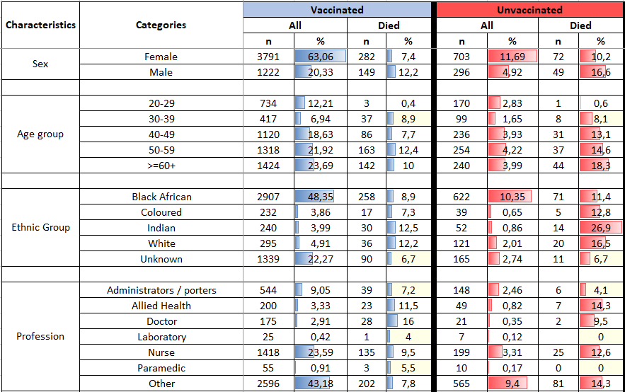
Results & Discussions
Table 1: Vaccination and mortality status for COVID-19 admissions amongst HWs (N = 6012)
Notes:
Most (83,38%) of the admitted health workers were vaccinated (only 16,61% unvaccinated).
There were more female HWs vaccinated than males but also lets not forget that the female HWs workforce is more than the males. However male HW had a higher mortality rate than females in both the vaccinated and unvaccinated groups.
Not much of a difference in the numbers of HWs vaccination proportions between age groups. The mortality rate amongst the vaccinated was highest in HW aged 50 to 59 followed by those 60 and above while the mortality rates in the unvaccinated increased as the age groups increased.
Unfortunately the data had quite a significant proportion of unknown ethnic groups which has limited the accuracy of the studies findings.
There were more people of the black ethnicity than the other ethnic groups which were relatively similar but also lets not forget that black people are the majority population group in South Africa.
The highest mortality rates amongst the vaccinated were observed in Indians and Whites (quite similar) then blacks and lastly coloreds (quite similar).
The highest mortality rates amongst the unvaccinated were observed in Indians (26,9%) followed by whites (16,5%) then blacks and lastly coloreds (quite similar).
Nurses were the largest HW category admitted followed by admin/porters, allied HWs, doctors, paramedics and lastly lab HW. Workers with different professions than the ones mentioned were combined and contributed to the largest cohort (43%) in this study.
The highest mortality rates amongst the vaccinated were doctors (16%), allied health (11,5%), nurses (9,5%), other profession, administrators/porters (I don’t like how administrators and porters were grouped together because their job process is very different) paramedics and laboratory respectively.
Dissimilarly, the highest mortality rates amongst the unvaccinated were observed in allied health and other profession equally at 14,3% then nurses, doctors and admin/porters. The remainder of the groups did not have deaths (small numbers but its was what was available).
Generally vaccinated HWs had reduced odds of in-hospital mortality.

Slide 8
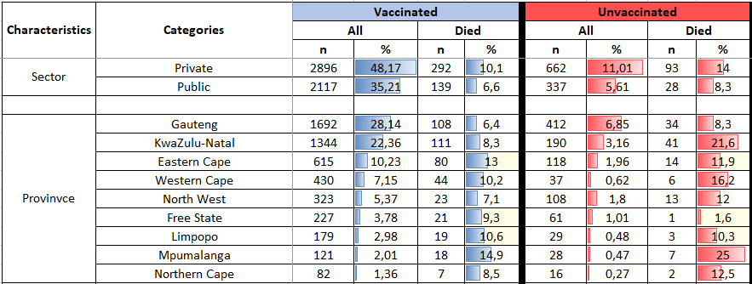
Results & Discussions
Table 2: Vaccination and mortality status for COVID-19 admissions amongst HWs and environmental factors (N = 6012)
Notes:
Most of the vaccinated and unvaccinated HW sought to be admitted at private health facilities (maybe the HW opted to vaccinate because they are more confident that worst case scenario they can expect better service delivery from this sector). On the other hand the mortality rates at the private sector are higher than the public sector.
But still generally vaccinated HWs had reduced odds of in-hospital mortality.
The second part of the table shows the number of HW hospital admissions per province in descending order starting with GP, KZN, EC, WC, NW, FS, L, MP and lastly NC.
In descending order, the mortality rates amongst vaccinated HWs were highest in MP (14,9%), EC (13%), L (10,6%), WC (10,2%), FS (9,3%), NC (8,5%), KZN (8,3%), NW (7,1%) and GP (6,4%).
Not identically, in descending order, the mortality rates however amongst unvaccinated HWs were highest in MP (25%), KZN (21,6%), WC (16,2%), NC (12,5%), NW (12%), EC (11,9%), L (10,3%), GP (8,3%) and FS (1,6%).
(Add IQR)

Slide 9
Results & Discussions
Table 3: Vaccination and mortality status for COVID-19 admissions amongst HWs and their comorbidities (N = 6012)
Notes:
The table shows the frequency of HW hospital admissions comorbidities in descending order starting with Hypertension then …………….
In descending order, the mortality rates amongst vaccinated HWs were highest in HW with chronic renal disease (30%), Cancer (25%), Diabetes (18,5%), Chronic pulmonary disease (18,2%), Hypertension (15,1%), Asthma (12,4%), HIV (10,9%), history of TB (8,6%), have TB (7,1%) and chronic cardiac disease (6,6%).
Not identically, in descending order, the mortality rates amongst unvaccinated HWs comorbidities was highest in HW with diabetes (20,6%), hypertension (20,1%), Asthma (17%), HIV (16,3%) and active tuberculosis (14,3%).
However, there were no deaths from unvaccinated HWs with chronic cardiac disease, chronic pulmonary disease, history of TB, cancer and chronic renal disease! Rather suspicios.

Slide 10
Discussions
This study
83% vaccination uptake. Statistically significant increased likely hood of the hospitalised HWs to have received the COVID-19 vaccine if they are working as doctors, nurses. Also admissions in Eastern Cape, KwaZulu-Natal and Western Cape.
Statistically significant decreased odds to have received the COVID-19 vaccination were observed in admitted HWs who were, of the Caucasian ethnic group. Also admitted in a public health facility.
Other studies
59% were non hesitant to vaccinate. Physicians were more likely to accept COVID-19 vaccination than administrative support staff, HWs aged 55 to 78 years, 45 to 54 years, and 35 to 44 years compared to participants aged 18 to 24 years (Cape Town: n = 395).
39,7% willingness to vaccinate. Less likely to receive COVID-19 vaccination < 30 years old. Doctors and nurses were more willing to vaccinate than other professions (Ethiopia: n = 614).
49,5% willing to vaccinate. Vaccine acceptance was predicted significantly by younger age, Doctors, Nurses and other allied health professionals (Nigeria: n = 422).
49,9% willing to vaccinate. Presence of a chronic diseases, being male and being a health worker were associated with increased likelihood to vaccinate (Zimbabwe: n = 1168).
70% willingness to vaccinate. Significant determinants of likelihood of participating in COVID-19 vaccine trial were HWs of older age. HWs in private health facilities were less likely to participate in a COVID-19 vaccine trial (Ghana: n = 1605).
Notes:
The studies do have other determinants discussed but I only included the variables that were available in our study.
61% willingness to vaccinate. Doctors were more willing to take COVID-19 vaccination than nurses. Older age, male (South East Asia: n = 3396).

Slide 11
Conclusions & Recommendations
There was good COVID-19 vaccination uptake and HWs that were vaccinated generally had reduced odds of in-hospital mortality, although immunocompromised patients in the study had persistently high risk of mortality despite being vaccinated.
Vaccine uptake is relatively understudied, such findings can offer important new insights about potentially modifiable factors.
Future research should include qualitative research to seek to identify determinants and mechanisms, in order to inform intervention strategies for groups found to be less likely to be vaccinated. The information about what influences vaccine decisions and behaviours can be used by the global health community to design effective implementation strategies and behavioural interventions to ensure high coverage of the COVID-19 vaccine.

Slide 12
Acknowledgements
National Institute for Communicable Diseases
National Institute for Occupational Health

Slide 13
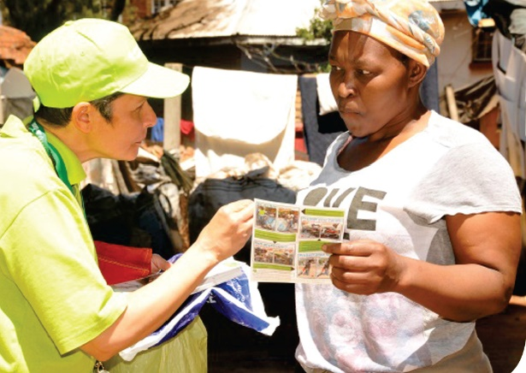
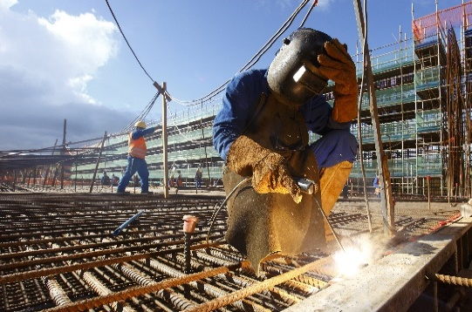
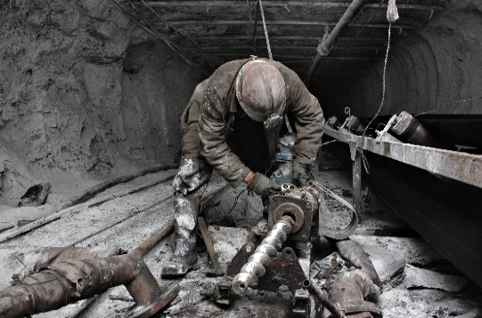
Healthy, Safe, Happy & Sustainable Workplaces WWW.NIOH.AC.ZA | TWITTER: @NIOH_SA | INFO@NIOH.NHLS.AC.ZA

